Slide 1
DATA - UCI Capstone 2023
Mar 17, 2023
Frank Dong, Yang Weng, Nima Hendi, Sean Youngseon

Slide 2
Energy uses Prediction:
Source:
Fossil Fuels:
Coal, Natural Gas, Petroleum
Nuclear Electric
Renewable Energy
Net Interstate Flow
Total
(add on if needed: mixed Natural Gas, distillate Fuel Oil, Mortar Gasoline & Fuel Ethanol)
Sector:
Residential
Commercial
Industrial

Slide 3
Understanding the problem
Price
GDP
Others
Based on the common sense, the price is the most important things for people to make decision.
From the global view of the economy, the GDP is an important feature.
About more than three hundreds of different data for further EDA.

Slide 4
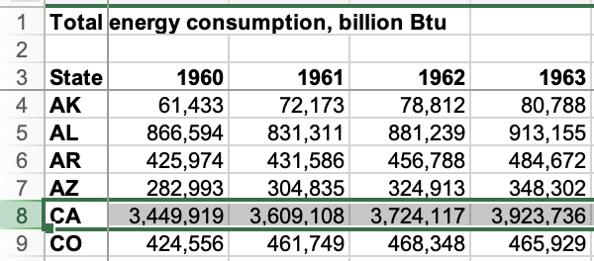
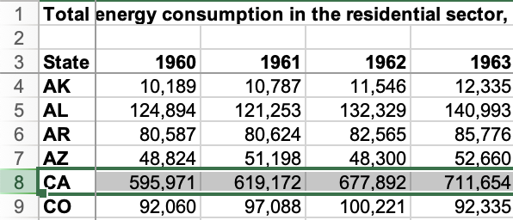
Data Sets
Yearly total consumption
Total energy consumption in the residential sector, billion Btu
Also the same format for other sectors.

Slide 5
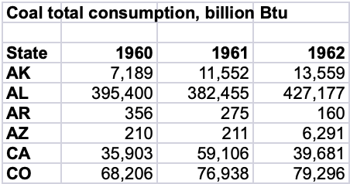
Data sets
Energy Consumption by Source
Same data for Natural Gas, Petroleum, Nuclear, Total Renewable Energy

Slide 6
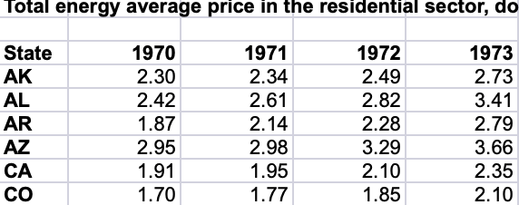
Supplemental data sets
Total energy average price in the residential sector, dollars per million Btu
Date sets:
Total energy average price
expenditures as percent of GDP
Same data for Commercial, industrial, and total.

Slide 7
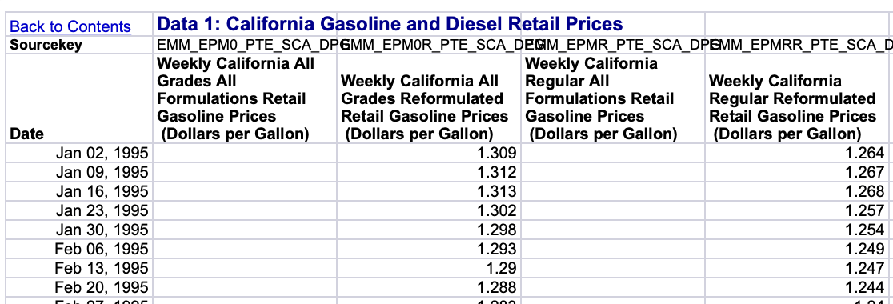
Supplemental data sets
California Gasoline and Diesel Retail Prices (May related to residential Energy use and commercial truck)

Slide 8
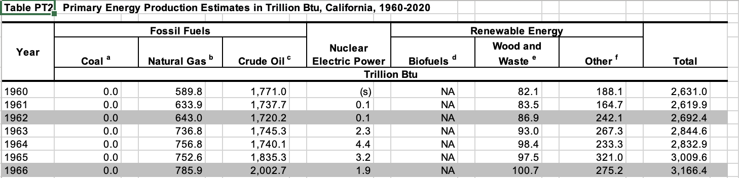
Supplemental data sets
Primary Energy Production Estimates in Trillion Btu, California, 1960-2020

Slide 9
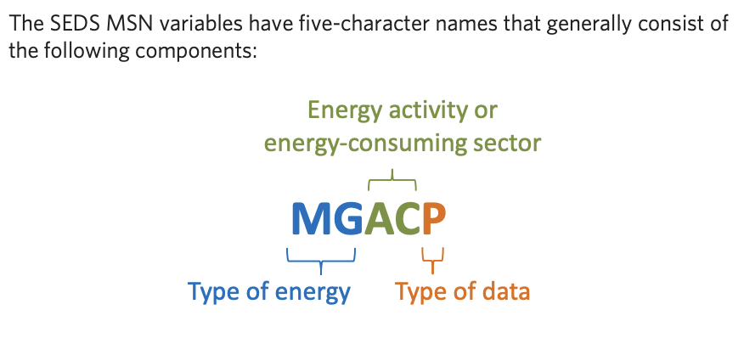
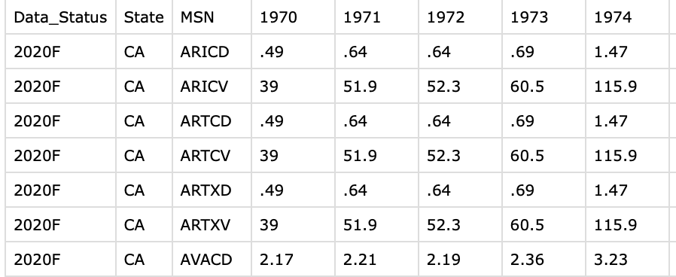
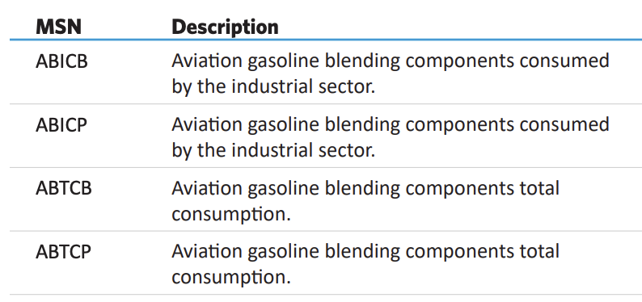
Supplemental data sets
MSN variable
Prices(304 categories)

